Slide 1

Computational Physics (PHYS6350)
Lecture 5: Non-linear equations and root-finding: Part 2
Roots of polynomials
Systems of non-linear equations
Function extrema
January 31, 2023
Instructor: Volodymyr Vovchenko (vvovchenko@uh.edu)
Course materials: https://github.com/vlvovch/PHYS6350-ComputationalPhysics

Slide 2
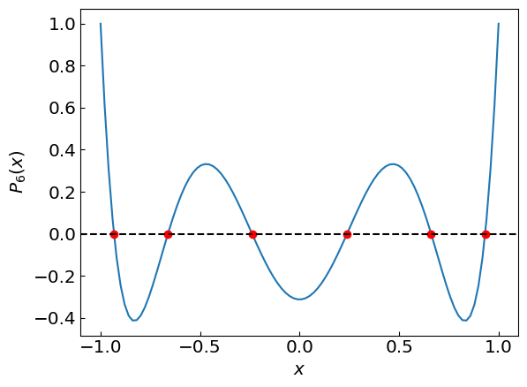
Roots of polynomials
References:
Chapters 5.1, 9.5 of Numerical Recipes Third Edition by W.H. Press et al.

Slide 3
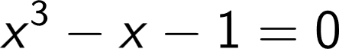
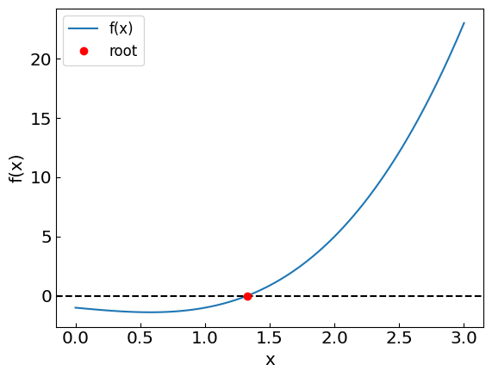
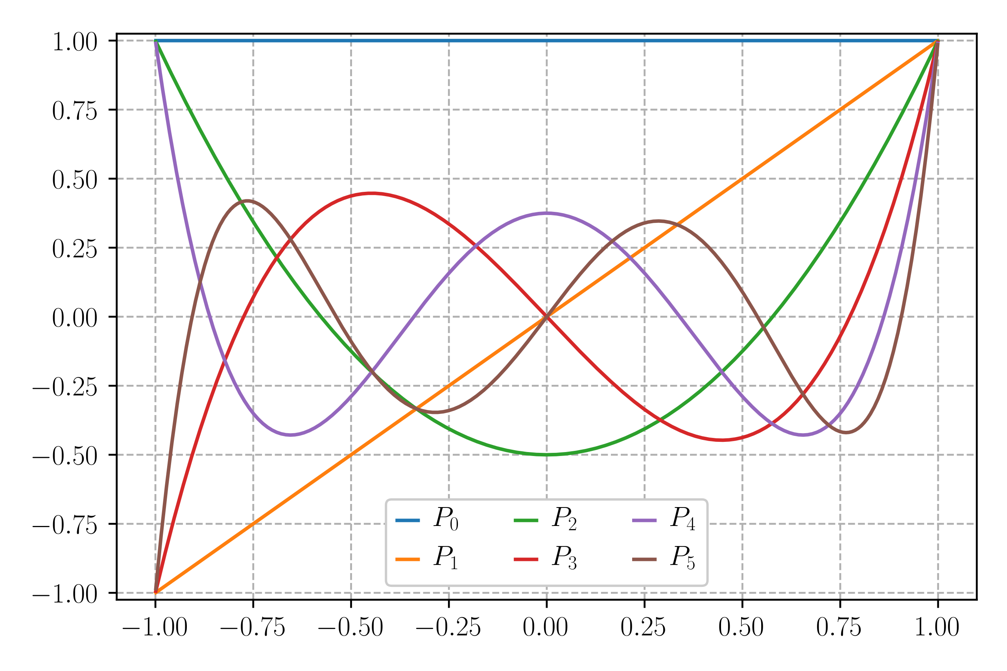
Roots of polynomials
So far we’ve dealt with polynomials with one real root, such as
Other polynomials (e.g. Legendre polynomials) have multiple real roots, and we need to calculate them all

Slide 4
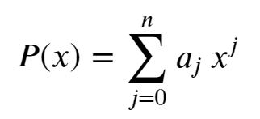
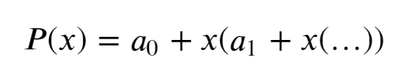
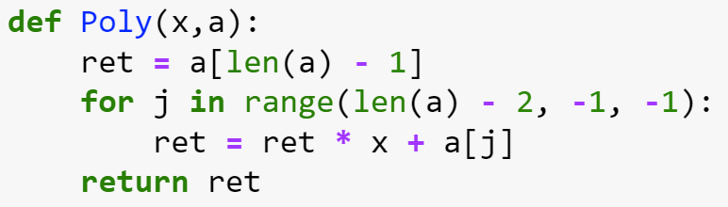
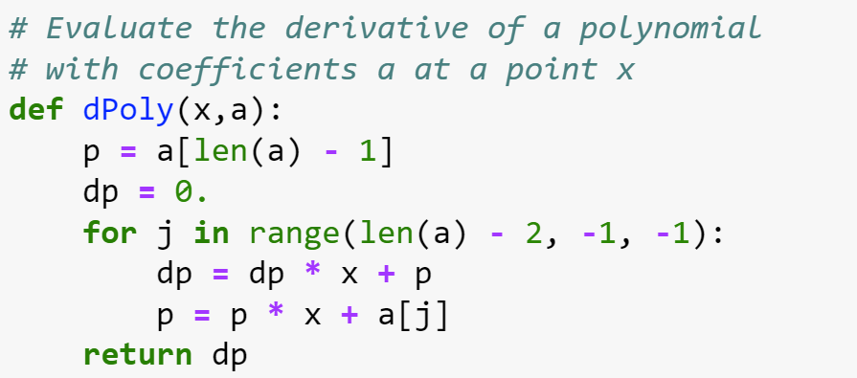
Preliminaries: evaluating polynomials efficiently
A polynomial can typically be written as
or, equivalently, as
which allows one to evaluate both the polynomial and its derivative efficiently

Slide 5
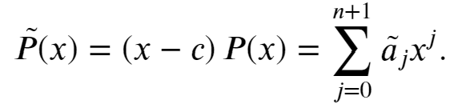
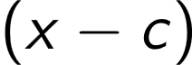
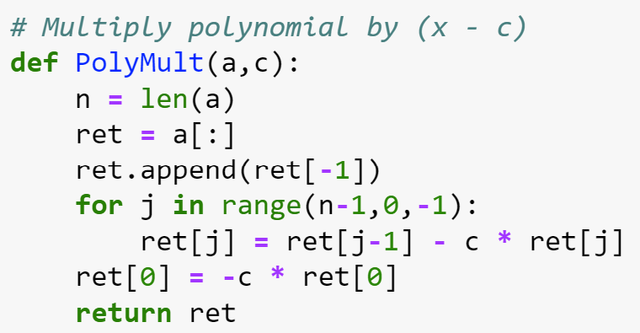
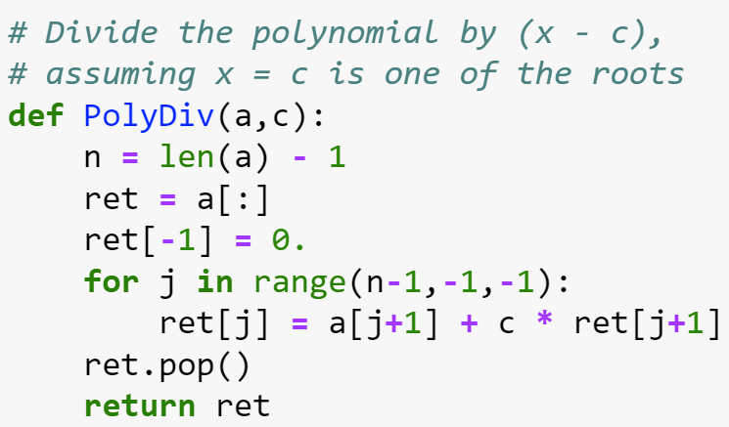
Preliminaries: multiplying and dividing a polynomial
Multiplication:
Multiply by to get
Easy to see that
Division:
Inverting these relations defines the division of $\tilde{P}(x)$ by (x-c)
Note that the division only makes sense with x=c is a root of $\tilde{P}(x)$

Slide 6
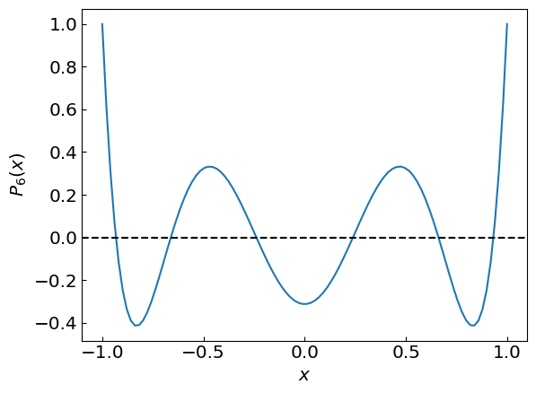
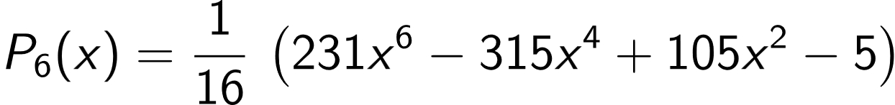
Roots of Lagrange polynomials
Roots of Lagrange polynomials $P_{n}(x)$ play an important role e.g. for numerical integration using quadratures
Each $P_{n}(x)$ has n real roots in the interval x = -1…1
Consider
How to evaluate its six roots accurately?

Slide 7
Roots of Lagrange polynomials
Strategy 1: Bracket each root from visual analysis and use the bisection method for refinement

Slide 8
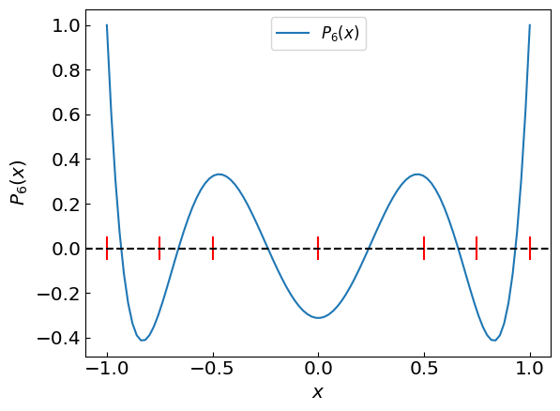
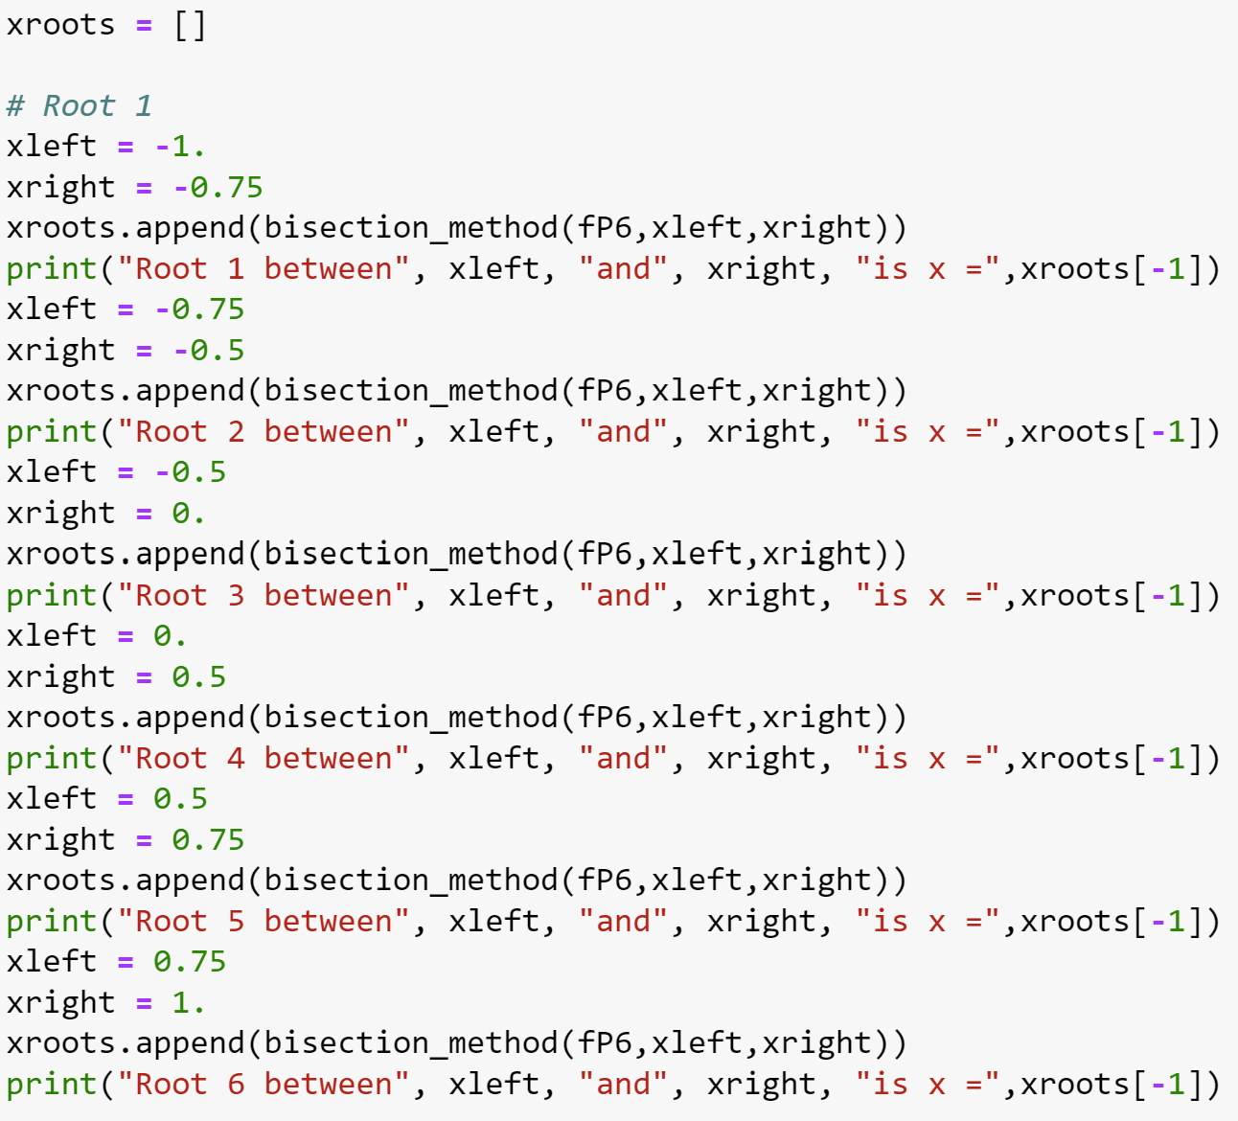
Roots of Lagrange polynomials
Strategy 1: Bracket each root from visual analysis and use the bisection method for refinement

Slide 9
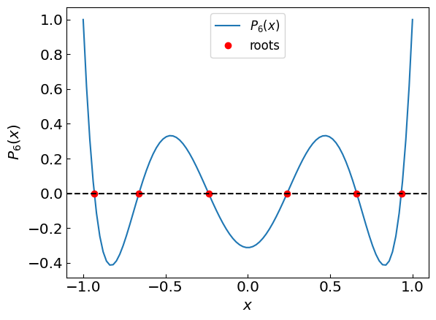
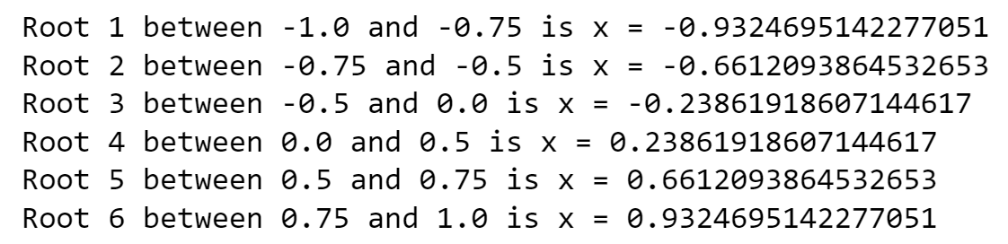
Roots of Lagrange polynomials
Strategy 1: Bracket each root from visual analysis and use the bisection method for refinement

Slide 10
Roots of Lagrange polynomials
Strategy 1 is fairly fail-safe but requires too much manual pre-processing
Strategy 2:
Use e.g. Newton’s method to find the first root x₁
Divide the polynomial by (x-x₁)
Apply Newton’s method to the new polynomial to find x₂
Divide the polynomial by (x-x₂) and repeat the above steps until all roots are found
Optional optimization:
Refine the roots by applying Newton’s method again to the original polynomial, using the tentative roots as initial guesses
This helps to mitigate round-off error accumulation inherent in polynomial division

Slide 11
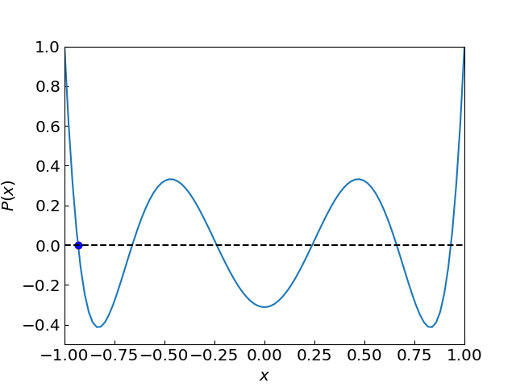
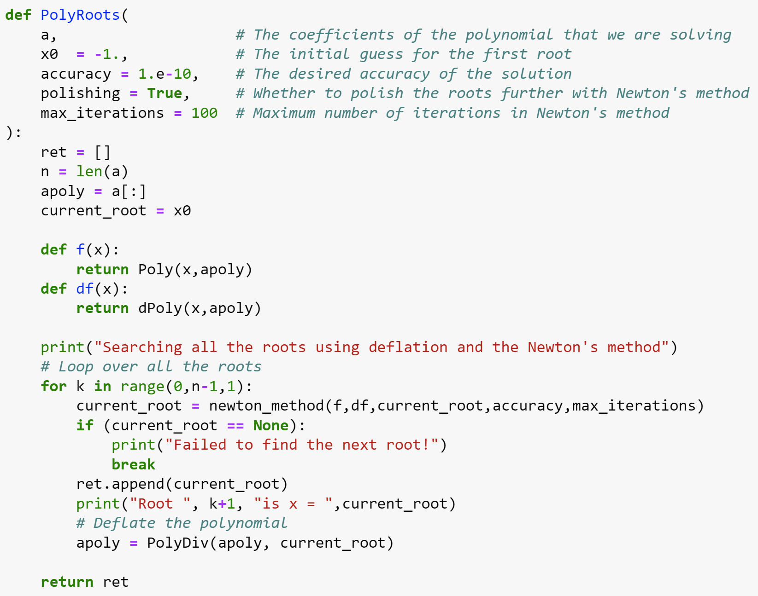
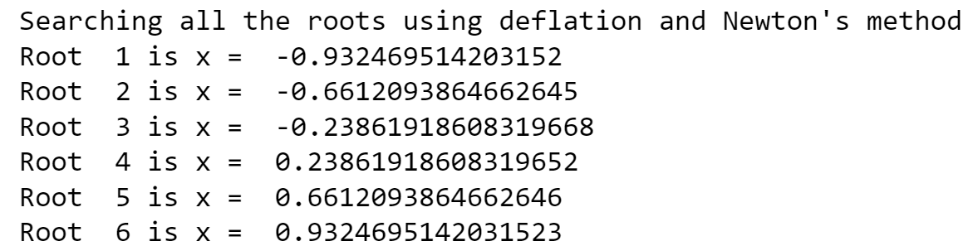
Roots of Lagrange polynomials
Using strategy 2, initial guess x₀ = -1

Slide 12
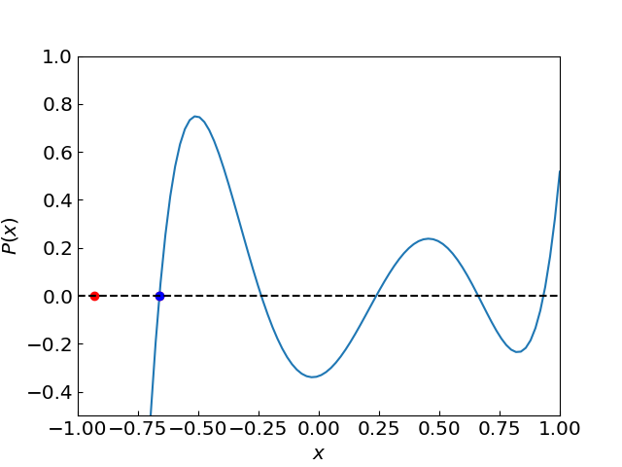
Roots of Lagrange polynomials
Using strategy 2, initial guess x₀ = -1

Slide 13
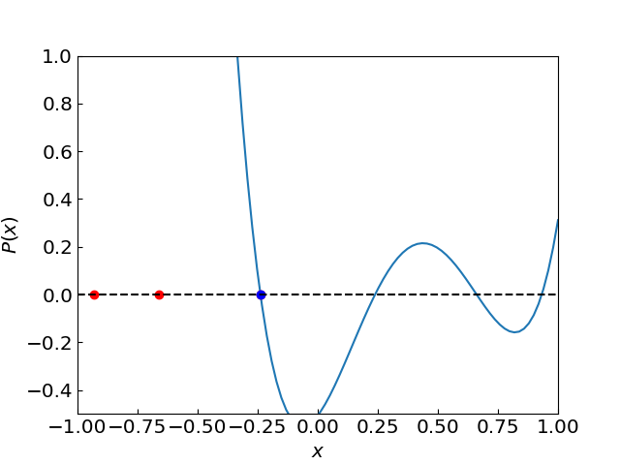
Roots of Lagrange polynomials
Using strategy 2, initial guess x₀ = -1

Slide 14
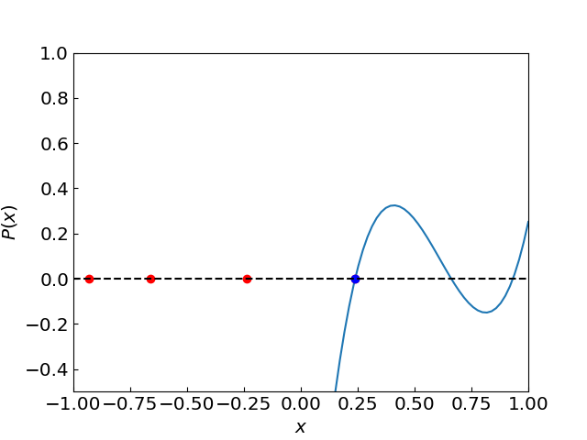
Roots of Lagrange polynomials
Using strategy 2, initial guess x₀ = -1

Slide 15
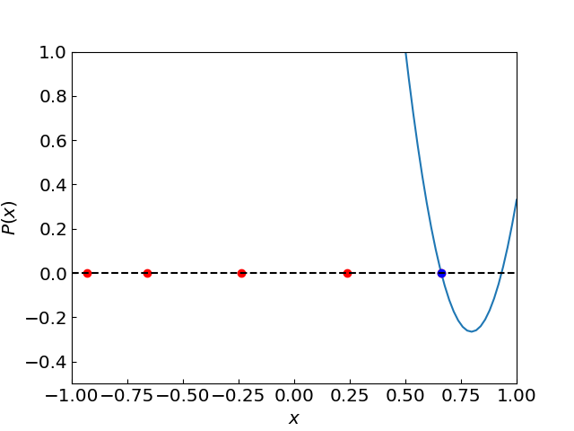
Roots of Lagrange polynomials
Using strategy 2, initial guess x₀ = -1

Slide 16
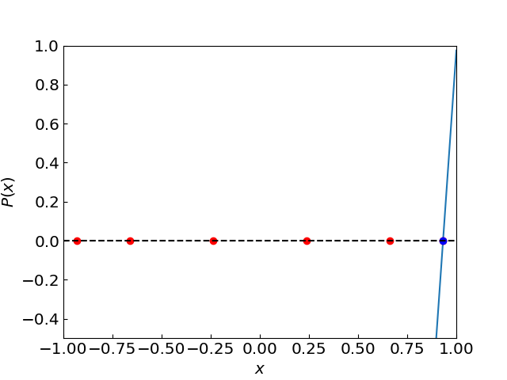
Roots of Lagrange polynomials
Using strategy 2, initial guess x₀ = -1

Slide 17
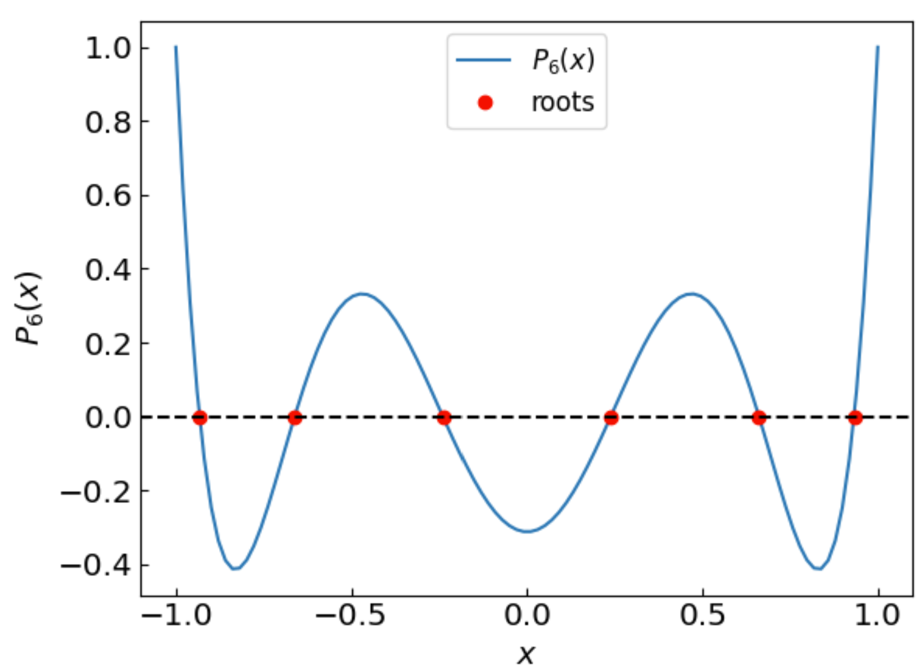
Roots of Lagrange polynomials
Using strategy 2, initial guess x₀ = -1

Slide 18
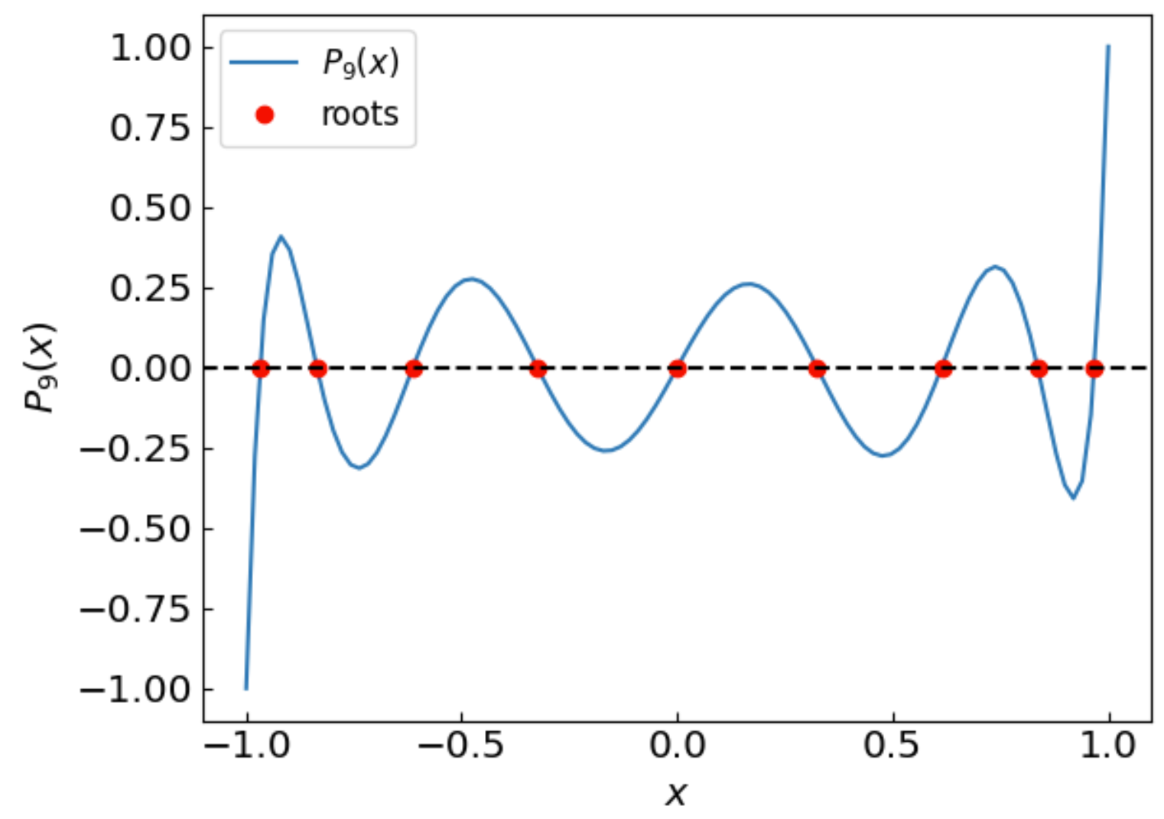
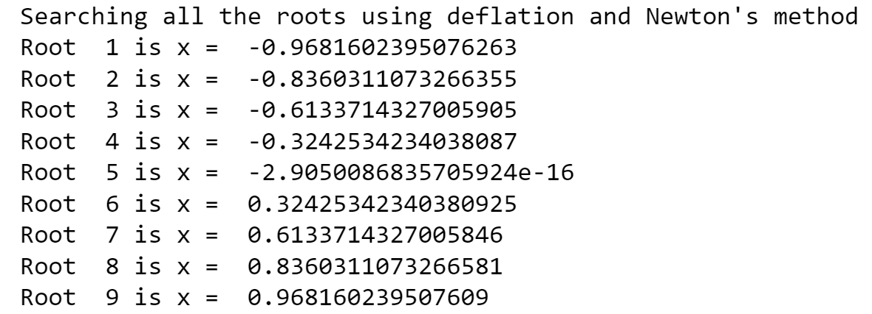
Roots of Lagrange polynomials
Same procedure for $P_{9}(x)$

Slide 19
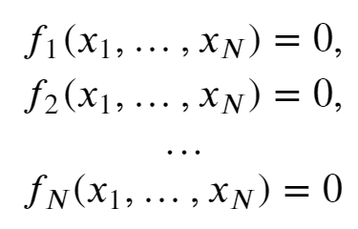
Systems of non-linear equations
References:
Chapter 9.6 of Numerical Recipes Third Edition by W.H. Press et al.

Slide 20
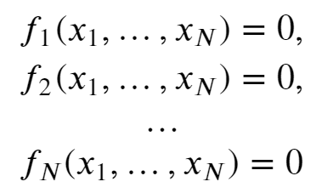
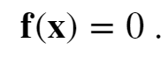
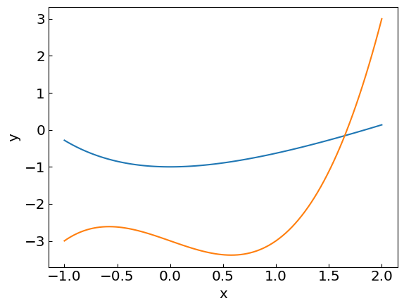
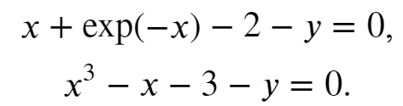
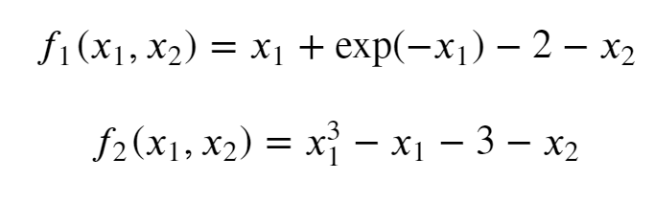
Systems of non-linear equations
Sometimes we need to solve a system of non-linear equations, e.g.
For example:
i.e.

Slide 21
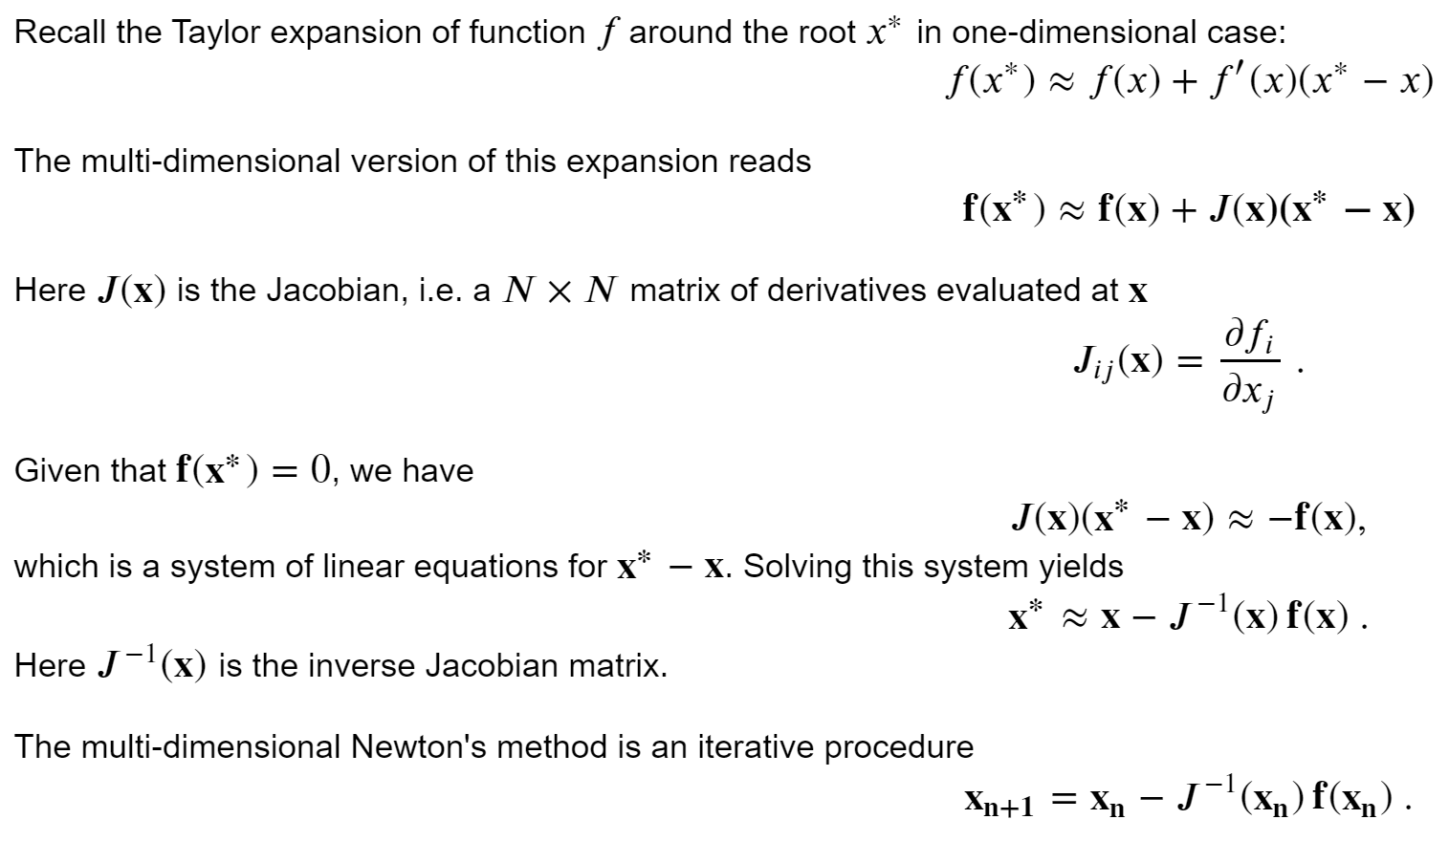
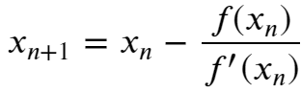
Newton-Raphson method in multiple dimensions
Reduces to Newton’s method in 1D

Slide 22
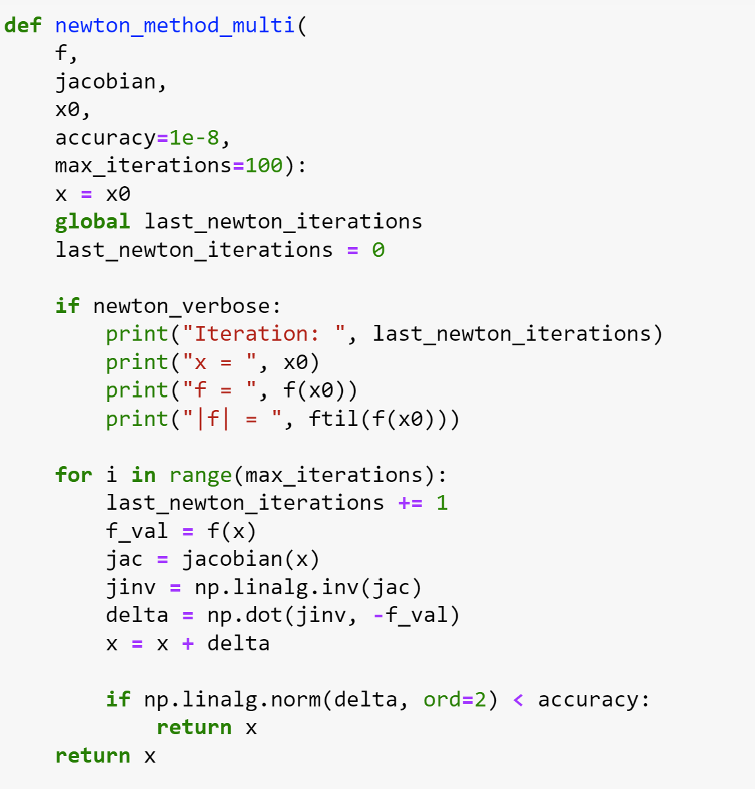
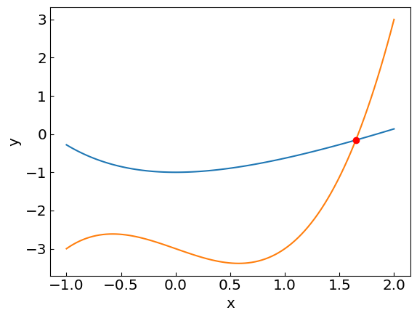
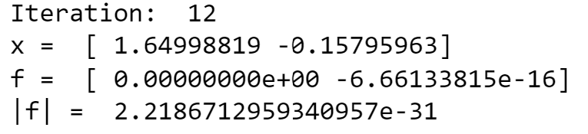
Newton-Raphson method in multiple dimensions

Slide 23
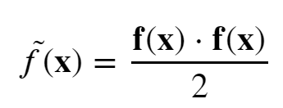
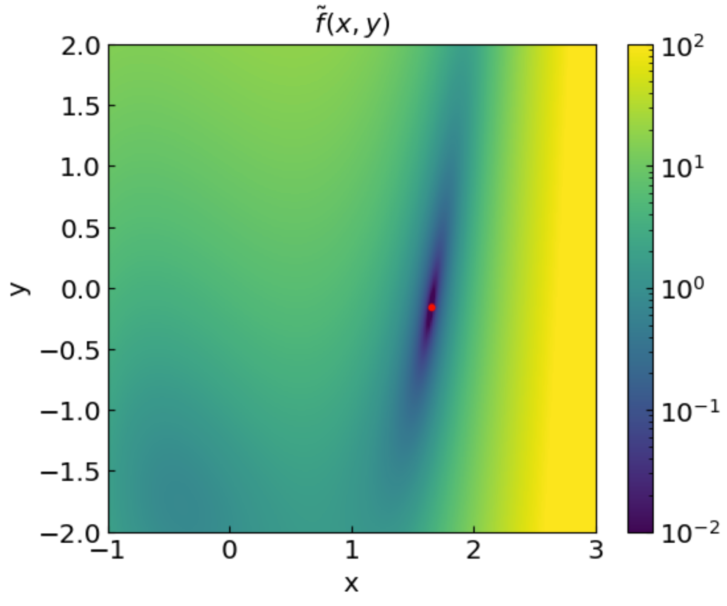
Newton-Raphson method in multiple dimensions
Introduce an objective function
Its value is equal to zero (minimized) at the root

Slide 24
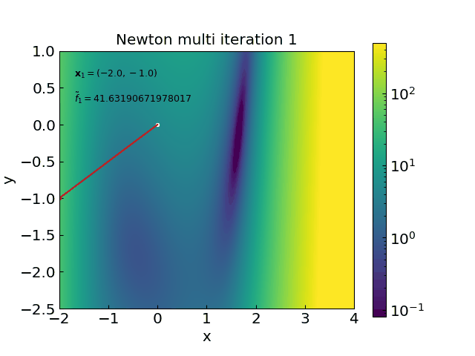
Newton-Raphson method in multiple dimensions

Slide 25
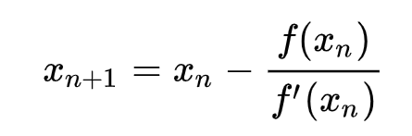
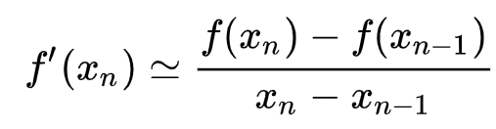
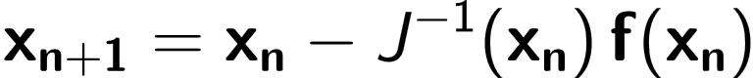
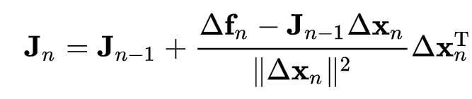
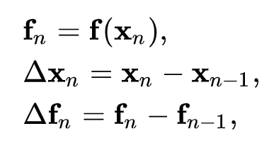
Broyden method
Broyden method is a multi-dimensional generalization of the secant method
Secant method:
with
Broyden method:
with
The solution to is not unique
Broyden:
with
For $J_{0}$ one can take the identity matrix or full Jacobian calculated once

Slide 26
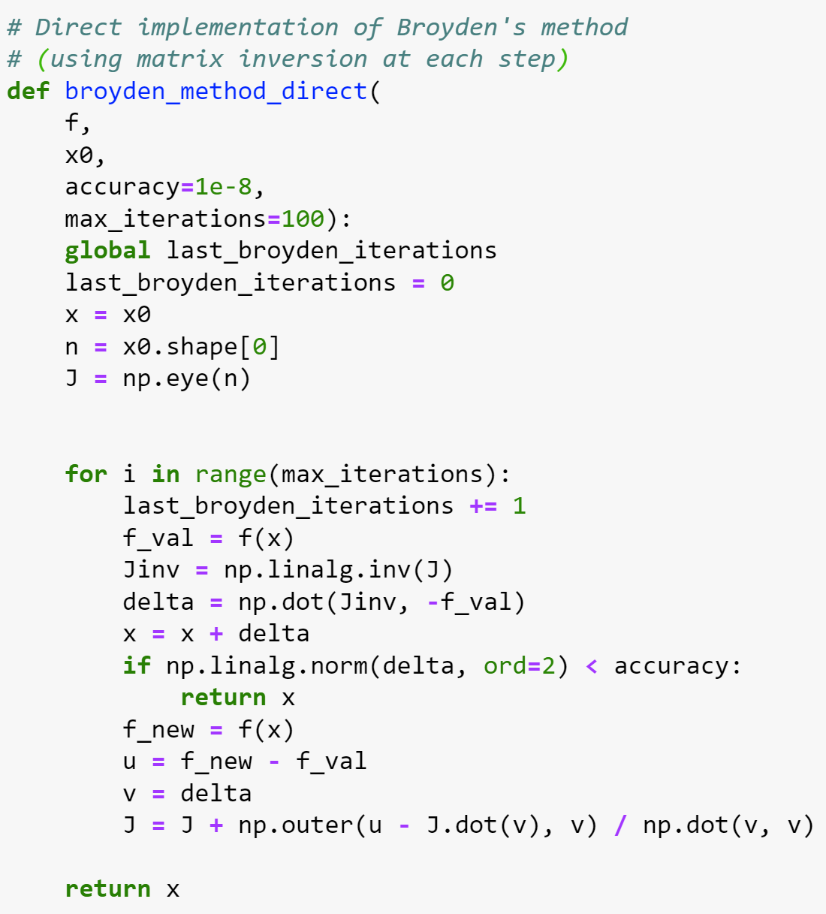
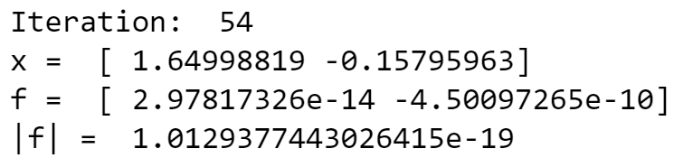
Broyden method (direct)

Slide 27

Broyden method: avoid matrix inversion
Sherman-Morrison formula:
Update the inverse Jacobian directly!

Slide 28


Broyden method (Sherman-Morrison)

Slide 29
Broyden method vs Newton-Raphson method
Broyden method converges somewhat slower (e.g. 54 vs 12 iterations in our example) but:
Does not involve the calculation of Jacobian
Does not involve matrix inversion

Slide 30

Broyden method vs Newton-Raphson method
Broyden method converges somewhat slower (e.g. 54 vs 12 iterations in our example) but:
Does not involve the calculation of Jacobian
Does not involve matrix inversion
Possible refinement: improve the initial estimate for the Jacobian

Slide 31

Function minimization/maximization
References:
Chapter 6.4 of Computational Physics by Mark Newman
Chapter 10 of Numerical Recipes Third Edition by W.H. Press et al.

Slide 32

Function extrema
Often we are interested to find the minimum of a function (e.g. energy minimization)
Consider the minimum of f(x)=sin(x) on interval 0..2$π$

Slide 33



Golden section search
Bracket the minimum x_{min} in (a,b)
Take c = b – (b-a)/$φ$ and d = a + (b-a)/$φ$
if f(c)<f(d), take b = d as new right endpoint
Otherwise, take a = c as new left endpoint
Repeat over the new interval (a,b) until the desired accuracy is reached
$$φ=\frac{1+\sqrt{5}}{2}=1.618…$$
is the golden ratio
This value ensures that the interval decreases by factor $φ$ no matter what

Slide 34

Golden section search
To search for maximum of f(x) look for minimum of –f(x)

Slide 35



Newton method
The extremum of f(x) is the root of the derivative, $f^{′}\left(x\right)=0$
Simply apply Newton-Raphson method for finding the root of $f^{′}\left(x\right)$

Slide 36



Gradient descent method
Replace, ${f′}^{′}\left(x\right)$ by a descent factor $1/γ_{n}$
Freedom in choosing $γ_{n}$
Can be generalized to multi-variable function F(x₁,x₂,...)

